Slide 1
Foursquare Data, A Poor Substitute for Identifying Similar Neighborhoods
Shahrad Ardaghi
March 15, 2019

Slide 2
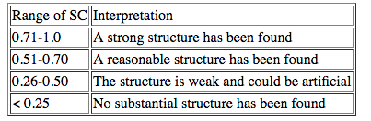
Introduction - Problem
Determining whether the clustering provided using the Foursquare Data and K-means provides a strong structure that can be relied on.
Comparing Data from four different cities: Manhattan, Toronto, City of Los Angeles, and Downtown LA
Will be using the Silhouette Coefficient to determine the strength of the structure

Slide 3
The Data/Methodology
Used the Data that was provided for Manhattan and the data acquired from the Toronto training exercise
The LA Data was acquired by scraping a Wikipedia Page to get the list of Neighborhoods and store the hyperlink of each Neighborhood
Used the hyperlink to get the coordinates for each Neighborhood
Aside from the categories made from the Foursquare data acquisition, also used the Foursquare category hierarchy to automatically create more general categories
Created custom categories for Manhattan Data (similar to the Foursquare category hierarchy)

Slide 4
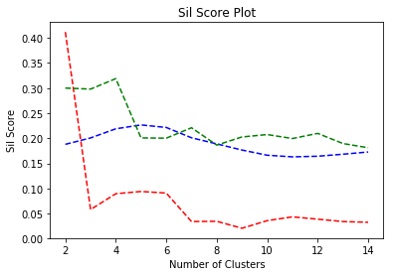
Results
Silhouette Score:
Red: Manhattan normal categories
Blue: M. customized categories
Green: M. auto categories

Slide 5
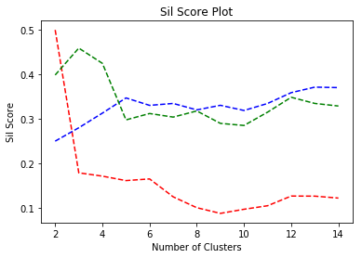
Silhouette Coefficient for Manhattan with PCA Reduction
Silhouette Score w/ PCA:
Red: Manhattan normal categories
Blue: M. customized categories
Green: M. auto categories

Slide 6
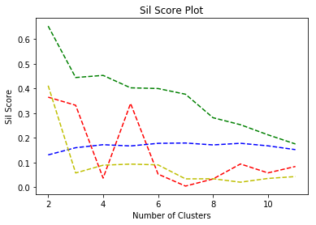
Silhouette Coefficient for all Cities, no category reduction, no PCA Reduction
Green: Toronto
Red: LA City
Blue: Downtown LA
Yellow: Manhattan

Slide 7
Discussion
The Silhouette Coefficient did not reach acceptable levels for almost all of the data sets. Only achieving a potentially acceptable level for the Toronto data, but by itself does not prove that the clustering was an acceptable structure
This is most likely because of three reasons:
1) a neighborhood cannot be grouped solely based on the ‘venues’ located within a neighborhood
(2) the categories provided by Foursquare are inadequate
(3) the ‘curse of dimensionality’
Factors (2) and (3) appear to be valid concerns based on the previous graphs showing the Silhouette Coefficient for changing the categories and reducing the number of dimensions

Slide 8
Conclusion
Using only Foursquare venue data to try and cluster similar neighborhoods together does not appear to be a valid use of the data or clustering algorithms.
It should be possible to create such a cluster if one used various techniques to refine the data. Perhaps the most important technique would be a better breakdown of categories.
As it stands the Foursquare categories seem ill-suited for the purposes of clustering similar neighborhoods.
Furthermore, neighborhood similarity based solely on the venue information provided by Foursquare seems to be very inadequate. One way to fix this might be to rely more heavily on demographic data instead of ‘venue’ data.
Furthermore, utilizing PCA reduction on a more refined dataset would most likely further assist in creating clustering’s with more validity.

